Slide 1
Adult Education Instruction at Off-campus Locations
Strategy for forging community partnerships that promote student success

Slide 2
This year Reinvention undertook analysis of our off-campus facilities as part of the broader effort to progress on Goal Number Four
Reinvention Goal Number Four: Increase number and share of ABE/GED/ESL students who advance to and succeed in college-level courses.
CCC partners with community- and faith-based organizations to have instruction take place at off-campus sties.
In order to meet Reinvention’s goal number four, we need to:
1) Enable student progress at off-campus sites
2) Promote transfer to City Colleges
5,791 adult education students enroll at off-campus locations.
Source: Fall 2011 Enrollment Data

Slide 3
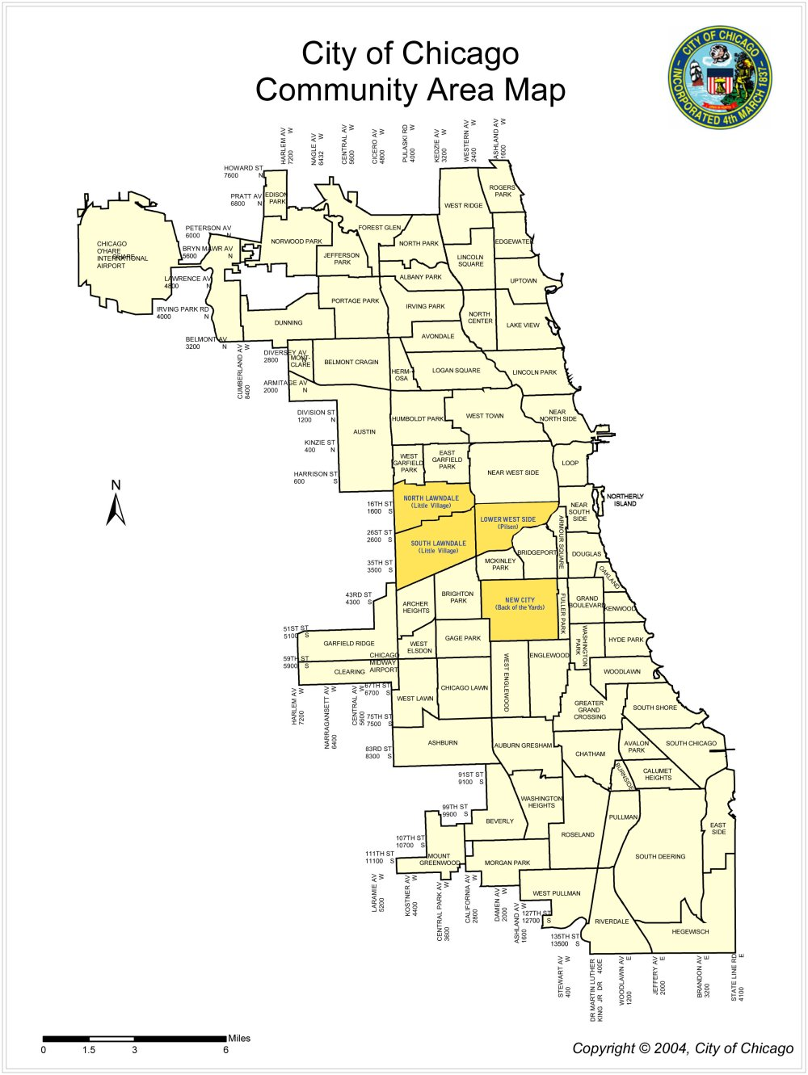
Reinvention wanted to visualize the location, affiliation and enrollment sizes for our off-campus locations
We charted off-sites onto an official City of Chicago map, color-coding to match to college affiliation.
This allows at-a-glance understanding of geographic spread of off-campus sites per college.
We researched which neighborhoods have a high number of residents who speak a language other than English at home, or do not have a high-school diploma, to answer the question:
Do we provide adult education in high-need areas?
JVS Vocational
ESL Program
283
52.4 / 52
All Saints
Cathedral
Legend
Wright College
4662
62.4 / 59
Copernicus Foundation
Christ Evangelical Luther
140
73.6 / 100
Truman College
7732
32.1 / 40
Site Name
FY 2011 Enrollment Number
FY 2010 % retained / % success
Success = Pass / Fail – end of term
Non-CCC-affiliated
Our Lady of Mercy Convent
463
71.9 / 56
Lutheran Church
Chopin Park
158
80 / 34
Polish American Association
Korean American Community Services
Lakeview Learning
1715
56.6 / 81
400 – 500 Enrollees
Daley-affiliated
Islamic Community Center
33
69.6 / NA
Northwest Neighborhood
225
74.1 / 59
Starting Point
Kennedy-King-affiliated
Our Lady of the Resurrection
Concordia Avondale
Heartland Care
St. Hyacinth Church
253
92.5 / 98
200 – 400 Enrollees
Malcolm X-affiliated
Northwest Free Will Baptist
107
77 / 100
James Monroe Elementary
130
85.6 / 26
100 – 200 Enrollees
Olive-Harvey-affiliated
Foreman High School
Christopher
House
Nuestra Senora
41
75 / 97
Darwin 8
Salvation Army
60 – 100 Enrollees
Mozart Comm. Ctr.
91
83.1 / 38
20 – 60 Enrollees
Truman-affiliated
Funston
126
82.7 / 45
West Town Coalition
450
82.8 / 36
Logan Sq. Library
45
96 / 76
NA / 0 – 20 Enrollees
Stowe
10
Wright-affiliated
McAuliffe
122
64.2 / 55
North / Grand HS
139
88.4 / NA
Providence
Family Service
144 52 / 81
Humboldt Park Voc.
999
64.5 / 78
West Park Academy
48
96 / 13
Association House
500
46.5 / 51
Northwestern US
111
83.1 / 53
St. Helen’s Church
20
100 / 100
Erie House
149
84.7 / 7
West Side Learning
842
42.2 / 23
West Side Learning Ctr.
2080
47 / 26
Malcolm X College
2080
47 / 26
Haymarket Center
82
81.6 / 10
Metro Corrections Center
51
41.4 / NA
St. Anthony Hospital
16
22.2 / NA
Clemente Orozco
72
78.7 / 13
The Learning Center
Juarez Community Academy
33
El Valor – Reyes Ctr
124
61 / 64
Manuel Perez
119
54.2 / 76
Farragut
87
67.4 / 34
Lincoln United
46
70 / 11
Telpochcali School
202
54.7 / 43
Arturo Velasquez
2615
67 / 75
Madero Middle
19
Piotrowski Park
103
61.9 / 42
Day Reporting Center
86
35.2 / 15
Chinese Christian UC 1
89
National Latino Ed. Institute
Dawson Technical
682
50 / 31
Instituto Father Yermo
156
86.7 / 38
Immaculate Heart of Mary
151
61.3 / 30
Center for New Horizons
DRAFT
San Miguel School
Tilden Community Center
Richard Lee Elementary
260
60 / 60
Kennedy-King College
2292
32.1 / 40
Woodlawn P/I
Daley College
4492
63 / 63
Our Place
on Ashland
Ark of
St. Sabina
42
76.2 / NA
Sullivan House
South Chicago Learning
1062
45 / 38
Olive-Harvey College
1178
31.1 / 23
A. Philip Adult Learning
HRDI
51
33.3 / NA
Salem Baptist Church
Metro Family Services
28
78.6 / 9
Knowledge Hook-Up Center
42
66.7 / 5
Eastside
United
27
77.4 / 4
E
G
G/E
Sources: Chicago Area Planning Council (APC), CCC Research Depts., CCC AE Deans

Slide 4
Aside from South Lawndale, neighborhoods with high need for GED and ESL courses are under-served by CCC
Neighborhoods with high ESL and GED need and relatively little City Colleges’ presence
 | Population | No diploma | English language learners | Present CCC Sites
Brighton Park | 45,368 | 2nd - 44.2% | 1st - 51.7% | 1
Gage Park | 39,894 | 3rd - 41.2% | 6th - 40.5% | 0
West Elsdon | 18,109 | 6th - 35.2% | 4th - 41.1% | 0
McKinley Park | 15,612 | 4th - 35.7% | 12th - 33.1% | 0
Hermosa | 25,010 | 5th - 35.4% | 9th - 37.8% | 1
Belmont Cragin | 78,743 | 10th - 34.1% | 3rd - 43.2% | 1
Neighborhoods in which City Colleges has a relatively high presence
 | Population | No diploma | English language learners | Present CCC Sites
Logan Square | 73,595 | 43rd – 18.5% | 19th – 24.2% | 8
Humboldt Park | 56,323 | 7th - 34.5% | 24th - 22.4% | 5
Lower West Side | 35,769 | 8th - 34.4% | 11th - 35.3% | 5
South Lawndale | 79,288 | 1st - 46.2% | 2nd - 47% | 5
West Town | 81,432 | 60th - 13.4% | 35th – 13.9% | 3
Source: Population data from 2010 Census, educational attainment and language data from Census American Community Survey 2005-2009

Slide 5
In April and May, CCC is undertaking several specific actions to better serve students at off-site locations, among them…
Implementing partnership identification through new zones
New selection process
1. Need Identification | Emphasize high-need areas
2. Organization identification | Partner with the best
3. Site evaluation | Meet CCC standards
4. Site validation | Ensure process was followed
5. Partnership | Initiate / renew service
Truman
Wright
Malcolm X
Promote advancement from off-site to campus
Kennedy-King
Example: Final level offered is intermediate
Daley
On-campus site
Off-campus site
Olive-Harvey
Beginning
Intermediate
Advanced

